Slide 1
Residual Analysis Recap
Part I

Slide 2
Assumptions for Simple Linear Regression
Linearity
A straight line may be inadequate.
Outliers may bias estimates.
Constant Variance (Equal Spread)
Estimates (Betas) are still unbiased.
Standard Errors are inaccurate, thus rendering tests and confidence intervals to be misleading.
Normality
Both the estimates and their standard errors are robust to non-normal distributions.
Similar to hypothesis testing, problems arise with long tails (outliers) and small sample sizes.
Violations will affect prediction intervals more than confidence intervals.
Independence
Lack of independence causes no bias in the estimates, although seriously affects standard errors. Need for more additional models and / or sampling methods.
Courses that will help: Time Series, Statistical Sampling, Applied Statistics (Stat 2!)

Slide 3
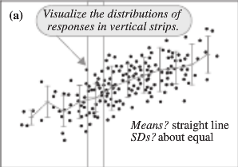
Model Assessment (Graphical)

Slide 4
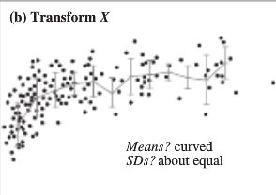
Model Assessment (Graphical)

Slide 5
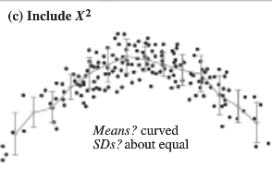
Model Assessment (Graphical)

Slide 6
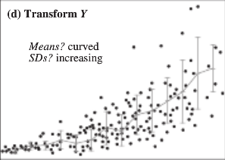
Model Assessment (Graphical)

Slide 7
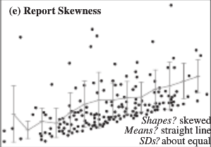
Model Assessment (Graphical)

Slide 8
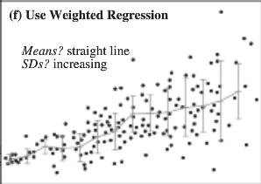
Model Assessment (Graphical)

Slide 9
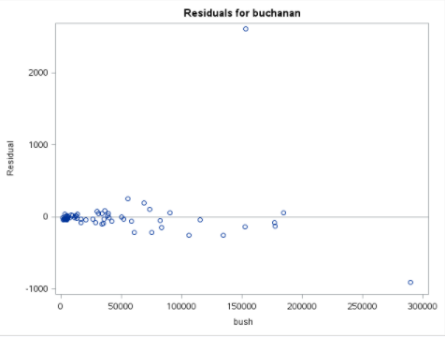
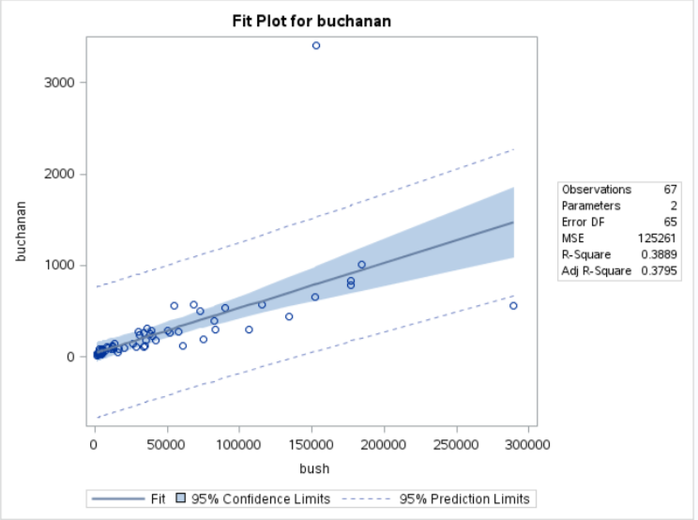
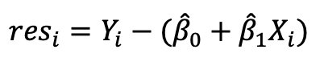
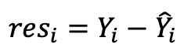
Scatterplot of Residuals
Removing (subtracting) the mean often reveals/highlights any non-linearity, non-constant variance, and/or outliers.
Remember:
Residual = Observed - Expected
$${res}_{i}=Y_{i}−{\hat{Y}}_{i}$$
$${res}_{i}=Y_{i}−({\hat{β}}_{0}+{\hat{β}}_{1}X_{i})$$

Slide 10
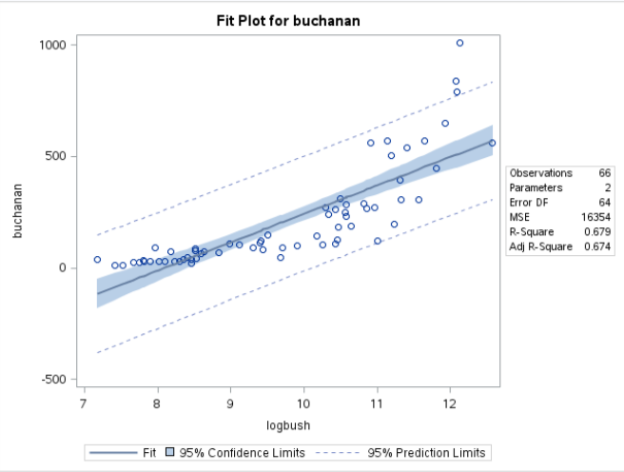
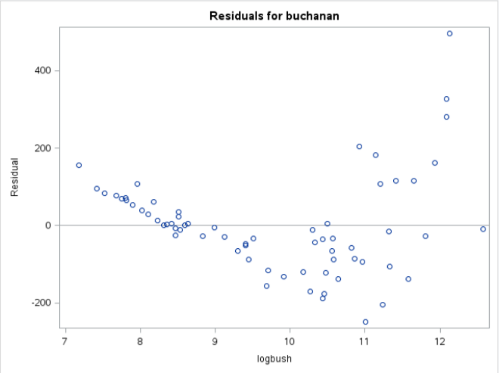
Residual Analysis
Curvature means non-random cloud: non-constant variance, non-linearity

Slide 11
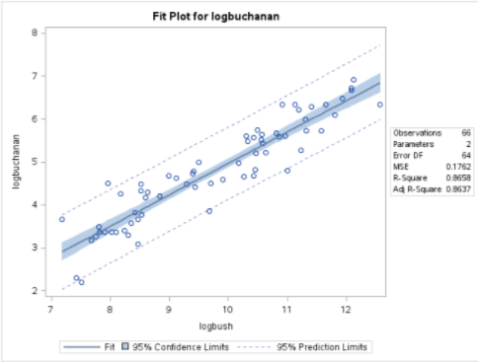
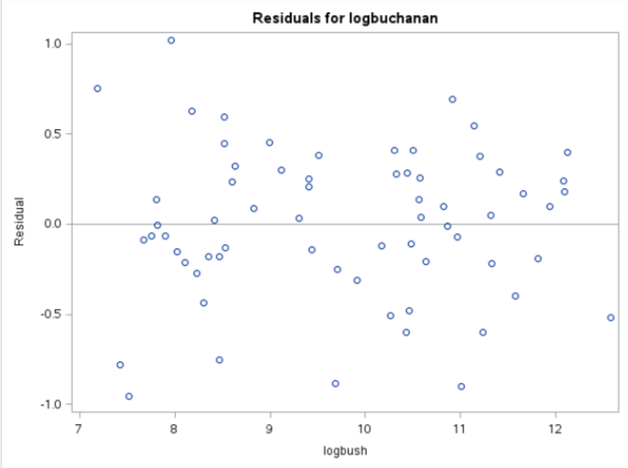
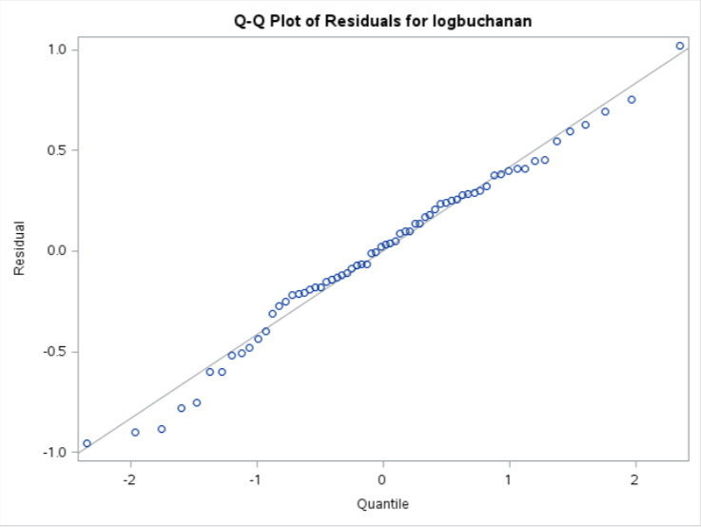
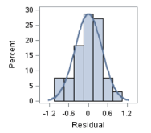
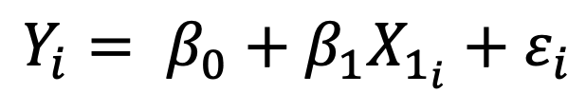
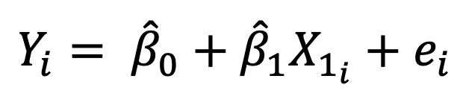
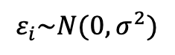
Checking Assumptions with Residuals
$$Y_{i}= β_{0}+β_{1}X_{1_{i}}+ε_{i}$$
If the assumptions are met, then:
$$ε_{i}\sim N(0,σ^{2})$$
${Each ε}_{i}$ (error) can be estimated with the residual of observation i (e_{i})!
$$Y_{i}= {\hat{β}}_{0}+{\hat{β}}_{1}X_{1_{i}}+e_{i}$$
Even scatter … linear trend … no curvature
Also .. Equal SD.
Linear
Residuals are normally distributed.

Slide 12
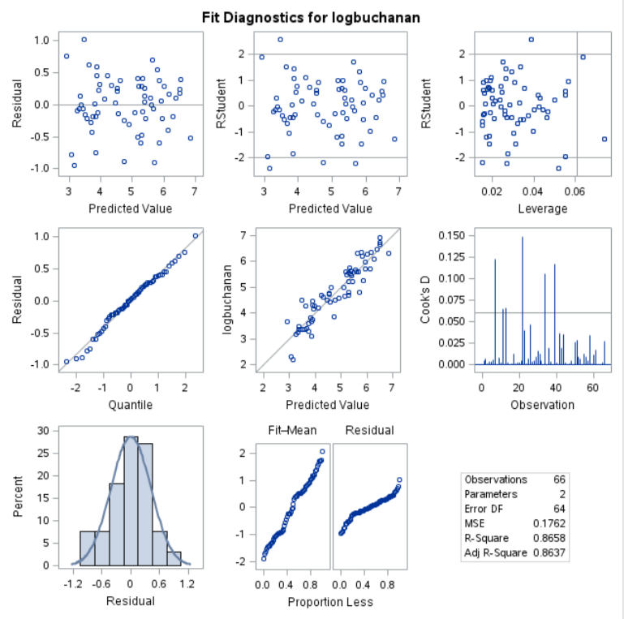
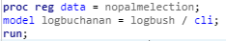
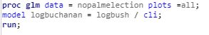
The Regression Panel

Slide 14
Residual Analysis Recap
Part II

Slide 15
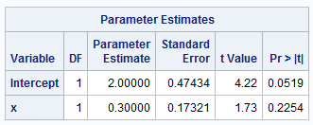
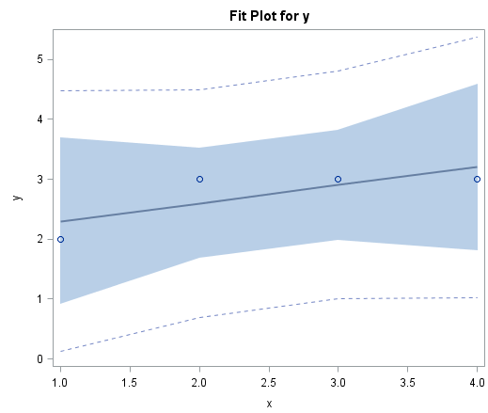
Data Set 1 (Excluded)
subject | x | y | group
1 | 1 | 2 | Exclude
2 | 2 | 3 | Exclude
3 | 3 | 3 | Exclude
4 | 4 | 3 | Exclude
5 | 1 | 2 | Include
6 | 2 | 3 | Include
7 | 3 | 3 | Include
8 | 4 | 3 | Include
9 | 30 | 50 | Include

Slide 16
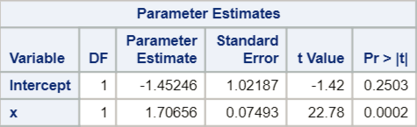
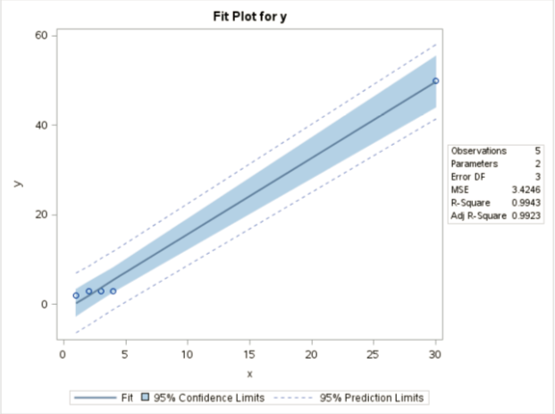
Data Set 2 (Included)
subject | x | y | group
1 | 1 | 2 | Exclude
2 | 2 | 3 | Exclude
3 | 3 | 3 | Exclude
4 | 4 | 3 | Exclude
5 | 1 | 2 | Include
6 | 2 | 3 | Include
7 | 3 | 3 | Include
8 | 4 | 3 | Include
9 | 30 | 50 | Include

Slide 17
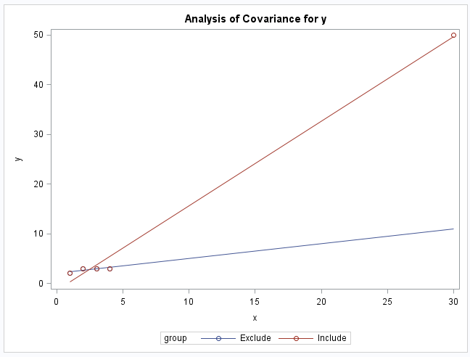
Excluded vs. Included

Slide 18

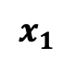
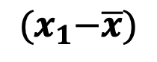
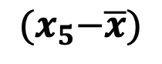
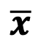
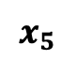
The Idea of Leverage
$$x_{5}$$
$$x_{1}$$
$$\overline{x}$$
$${(x}_{1}−\overline{x})$$
$${(x}_{5}−\overline{x})$$

Slide 19
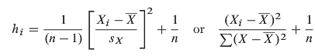
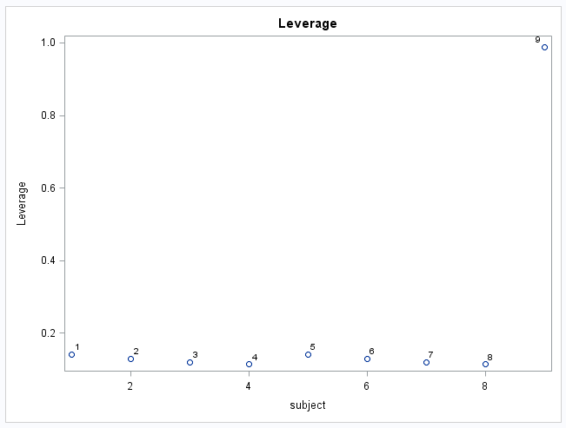
Definition of Leverage: (one explanatory variable)
leverage is a function of the distance from X_{i} to X_{bar}, in units of standard deviations
leverage is a function of the proportion of the total sum of squares of the explanatory variable contributed by the i^{th} case
x_{bar}
x_{i}
*combining all 9 pts into one dataset.

Slide 20
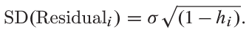
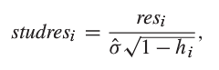
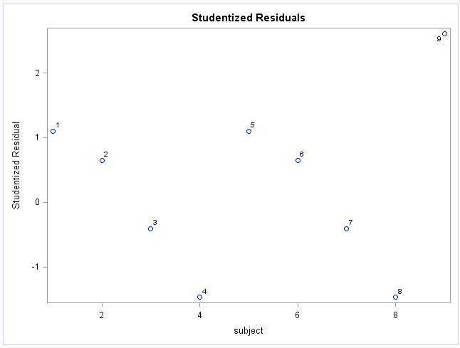
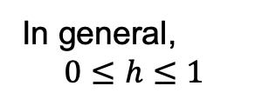
Studentized Residual
In general,
$$0≤h≤1$$
We “standardized” the normally distributed residual, so, under the assumption they are normally distributed only 5% of studres_{i} should be more extreme than +-2.

Slide 21
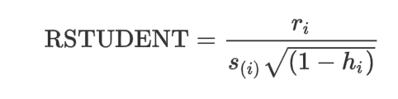
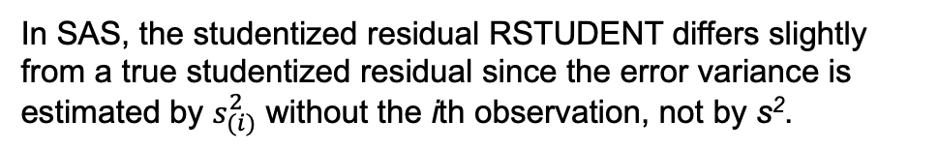
The Regression Panel
In SAS, the studentized residual RSTUDENT differs slightly from a true studentized residual since the error variance is estimated by $s_{(i)}^{2}$ without the ith observation, not by s².

Slide 22
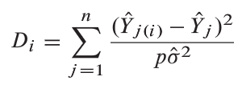

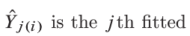
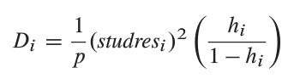
Cook’s Distance (D)

Slide 23
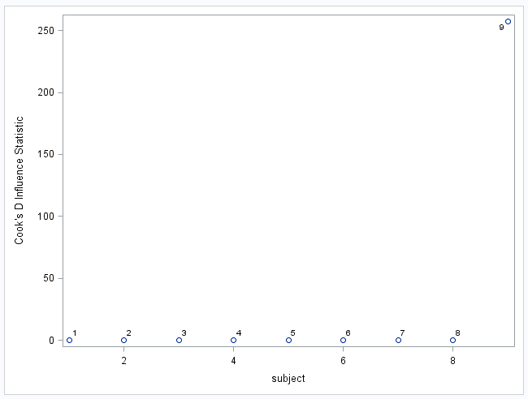
Cook’s D!
A Blend of Both!!!
D > 1 or D > 4/n might be influential.
residual
leverage

Slide 24
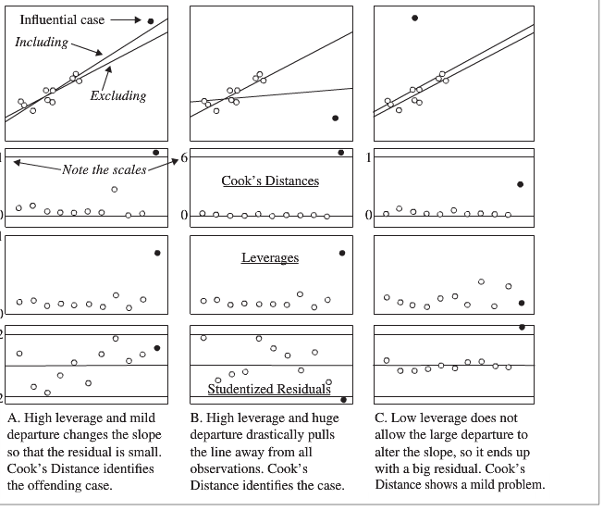

Studentized Residuals, Leverage and Cook’s D!

Slide 25
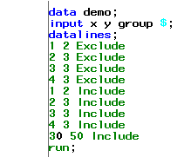
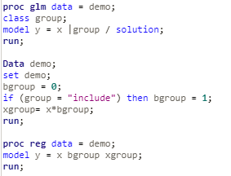
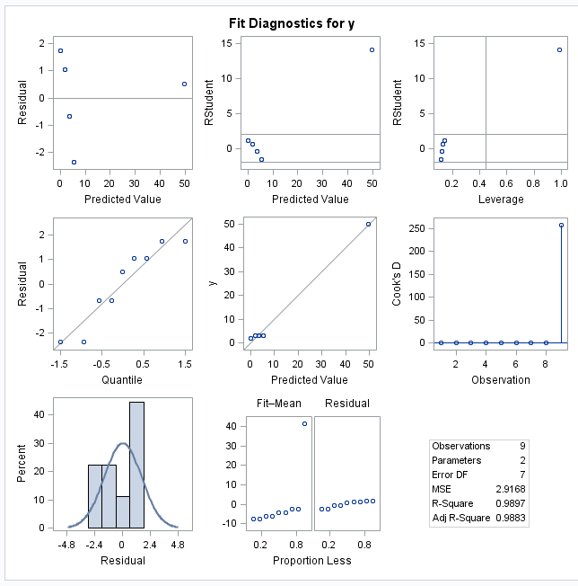
PROC REG or GLM

Slide 26
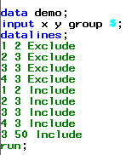
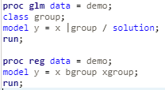


Proc Reg or GLM

Slide 28
Remedies for Violations
Part II

Slide 29

Log Transform

Slide 31
Derivation of Log-Linear Transformation

Slide 32






Log Transforms: Log-Linear
$μ\left\{\log\left(Y\right) | X\right\}=β_{0}+β_{1}\left(X\right)$
$$log⁡(Median\left(Y | X\right))=β_{0}+β_{1}(X)$$
$$e^{log⁡(Median\left(Y | X\right))}=e^{β_{0}+β_{1}X}$$
*Assume $\log\left(Y\right)=\log_{e}{(Y)}$ here
**$\log\left(Median\left(Y\right)\right)=mean\left(\log\left(Y\right)\right)$
*$a^{\log_{a}{y}}=y$ for any $a>0$
$$Median\left(Y | X\right)=e^{β_{0}}e^{β_{1}X}$$
and $Median\left(Y | X+1\right)=e^{β_{0}}e^{β_{1}(X+1)}$
$Median\left(Y | X+1\right)/ Median\left(Y | X\right)$
$Median\left(Y | X+1\right)/ Median\left(Y | X\right)$
$$Median\left(Y | X+1\right)/ Median\left(Y | X\right)$$
$$Median\left(Y | X+1\right)/ Median\left(Y | X\right)$$
$${=e}^{β_{0}}e^{β_{1}(X+1)}/e^{β_{0}}e^{β_{1}X}$$
$${=e}^{β_{1}(X+1)}/e^{β_{1}X}$$
$$={ e}^{β_{1}X}e^{β_{1}}/e^{β_{1}X}$$
$${=e}^{β_{1}}$$
Note: e = 2.718
(approximately)
Interpretation: A one unit increase in X is associated with a multiplicative change of $e^{β_{1}}$ in Median(Y|X).
** Note: We use a base of e for $e^{β_{1}}$ because the base on the log function was implied to be e. (Other bases could be interchanged.)

Slide 34
Example of Log-Linear Transformation

Slide 35

Insulation and Voltage Data
Time | Voltage
5.79 | 26
1579.52 | 26
2323.7 | 26
68.85 | 28
108.29 | 28
110.29 | 28
426.07 | 28
1067.6 | 28
7.74 | 30
17.05 | 30
20.46 | 30
21.02 | 30
22.66 | 30
43.4 | 30
47.3 | 30
139.07 | 30
144.12 | 30
175.88 | 30
194.9 | 30
In an industrial laboratory, under uniform conditions, batches of electrical insulating fluid were subjected to constant voltages until the insulating property of the fluids broke down. Seven different voltage levels, spaced 2 kilovolts apart from 26 to 38 kV were studied. The measured responses were the times, in minutes, until breakdown.
n = 76

Slide 36


Insulation vs. Voltage
proc reg data = insulation;
model time = voltage;
run;
Definite curvature, possibly nonconstant variance as well

Slide 37



Try a Log-Linear Model
$$μ\left\{\log{(Insulation)} | Voltage\right\}=β_{0}+β_{1}Voltage$$
Linearity looks much better.
Variance looks more constant. What looks like smaller spread might just be fewer data points at those levels.

Slide 38



Log Transforms: Log-Linear
$$Median\left(Y | X+1\right)/ Median\left(Y | X\right)$$
$${=e}^{β_{1}}$$
Interpretation: A one unit increase in X is associated with a multiplicative change of $e^{β_{1}}$ in Median(Y|X).
** Note: We use a base of e for $e^{β_{1}}$ because the base on the log function was implied to be e. (Other bases could be interchanged.)

Slide 39

Interpretation: Log-Linear
The data suggest each 1 kV increase in voltage is associated with a decrease in the median time to insulation breakdown by a factor of e^{−0.507 =} 0.6. That is, the median y at each value of x is estimated to be only 0.6 of the median y at one less unit of x. In other words, a one-unit increase in voltage is associated with a 40% decrease in median time to breakdown.
A 95% confidence interval for $β_{1}$is: $Point estimate±multiplier∗standard error$.
${\hat{β}}_{1}±t_{.975, 76−2}∗SE({\hat{β}}_{1}$)
−0.507 $±$ 1.99 * 0.0574
$\text{−}$0.507 $±$ 0.1142
(−0.621, −0.393)
Therefore, a 95% confidence interval for the multiplicative change in median time is (e^{−0.621}, e^{−0.393}) = (0.54, 0.68) ~ ($\text{−}$46%, $\text{−}$32%).
It is estimated that voltage explains about 51.36% of the variation in breakdown time of this insulation fluid.

Slide 41
Derivation of Linear-Log Transformation

Slide 42








Log Transforms: Linear-Log
$$μ\left\{Y | \log\left(X\right)\right\} \text{=} β_{0}+β_{1}\log\left(X\right)$$
$$μ\left\{Y | \log\left(X\right)\right\} \text{=} β_{0}+β_{1}\log\left(X\right)$$
$$and$$
$$μ\left\{Y | \log\left(2X\right)\right\} \text{=} β_{0}+β_{1}\log\left(2X\right)$$
$$μ\left\{Y | \log\left(2X\right)\right\}−μ\left\{Y | \log\left(X\right)\right\}$$
$$=β_{0}+β_{1}\log\left(2X\right)−\left(β_{0}+β_{1}\log\left(X\right)\right)$$
$$μ\left\{Y | \log\left(2X\right)\right\}−μ\left\{Y | \log\left(X\right)\right\}=β_{1}\log\left(2X\right)−β_{1}\log\left(X\right)$$
$$μ\left\{Y | \log\left(2X\right)\right\}−μ\left\{Y | \log\left(X\right)\right\}=β_{1}\left[\log\left(2X\right)−\log\left(X\right)\right]$$
$$μ\left\{Y | \log\left(2X\right)\right\}−μ\left\{Y | \log\left(X\right)\right\}=β_{1}\left[\log\left({2X}/X\right)\right]$$
$$μ\left\{Y | \log\left(2X\right)\right\}−μ\left\{Y | \log\left(X\right)\right\}=β_{1}\log\left(2\right)$$
Interpretation: A doubling of X is associated with a $β_{1}l$og(2) unit change in the mean of Y.
** Note: We use a base of e on the function log because that is the base used (implied) on the original data (other bases could be interchanged). The 2 in 𝜷_{𝟏} 𝐥og(2) is used because the x value was doubled.

Slide 44
Example of Linear-Log Transformation

Slide 45

Meat Processing and pH
A certain kind of meat processing may begin once the pH in postmortem muscle of a steer carcass decreases to 6.0 from a pH at time of slaughter of around 7.0 to 7.2. It is not practical to monitor the pH decline for each animal. So, an estimate is needed of the time after slaughter at which the pH reaches 6.0. To estimate this time, 10 steer carcasses were assigned to be measured for pH at one of five times after slaughter.

Slide 46



No Transforms: Linear
$$\hat{Y}=β_{0}+β_{1}⁡\left(X\right)$$
Curvature likely

Slide 47




Log Transforms: Linear-Log
$$\hat{Y}=β_{0}+β_{1}\log\left(X\right)$$
data steer;
set steer;
ltime=log(time);
run;
proc reg data = steer;
model pH =ltime;
run;
Linearity much better
Random cloud of residuals

Slide 48


Log Transforms: Linear-Log (cont.)
$$μ\left\{Y | \log\left(2X\right)\right\}−μ\left\{Y | \log\left(X\right)\right\}=β_{1}\log\left(2\right)$$
Interpretation: A doubling of X is associated with a $β_{1}l$og(2) unit change in the mean of Y.

Slide 49


Interpretation: Log-Linear
$$μ\left\{Y | \log\left(2X\right)\right\}−μ\left\{Y | \log\left(X\right)\right\}=β_{1}\log\left(2\right)$$
The data suggest that the predicted mean pH changes by ($−$0.7257)log(2) = $−$0.503 for each doubling of time.
A 95% confidence interval for $β_{1}$is: $Point estimate±multiplier∗standard error$.
${\hat{β}}_{1}±t_{.975, 10−2}∗SE({\hat{β}}_{1}$)
$\text{−}$0.7257 $±$ 2.31 * 0.03443
$\text{−}$0.7257 $±$ 0.0795
($\text{−}$0.8052, $\text{−}$0.6462)
A 95% confidence interval for $β_{1}Log\left(2\right)$ (or for the change in mean pH for each doubling of time) is:
[$\text{−}$0.805log(2), $\text{−}$0.646log(2)] = ($\text{−}$0.558, $\text{−}$0.448)
It is estimated that time explains about 98.23% of the variation in pH of steer carcasses.

Slide 51
Derivation of Log-Log Transformation

Slide 52






Interpretation Log-Log Model
$$μ\left\{\log\left(Y\right) | \log\left(X\right)\right\}=β_{0}+β_{1}\log\left(X\right)$$
$$\log\left(Median\left(Y | \log\left(X\right)\right)\right)=β_{0}+β_{1}\log\left(X\right)$$
*$\log\left(Median\left(Y\right)\right)=mean\left(\log\left(Y\right)\right)$
*$a^{\log_{a}{y}}=y$ for any $a>0$
$$e^{\log\left(Median\left(Y | \log\left(X\right)\right)\right)}=e^{\left[β_{0}+β_{1}\log\left(X\right)\right]}$$
$$Median\left(Y | \log\left(X\right)\right)=e^{\left[β_{0}+β_{1}\log\left(X\right)\right]}$$
and $Median\left(Y | \log\left(2X\right)\right)=e^{\left[β_{0}+β_{1}\log\left(2X\right)\right]}$
$$\frac{Median\left(Y | \log\left(2X\right)\right)}{Median\left(Y | \log\left(X\right)\right)}=\frac{e^{\left[β_{0}+β_{1}\log\left(2X\right)\right]}}{e^{\left[β_{0}+β_{1}\log\left(X\right)\right]}}=\frac{e^{β_{0}}e^{β_{1}\log\left(2X\right)}}{e^{β_{0}}e^{β_{1}\log\left(X\right)}}$$
$$\frac{Median\left(Y | \log\left(2X\right)\right)}{Median\left(Y | \log\left(X\right)\right)}=\frac{e^{β_{1}\log\left(2X\right)}}{e^{β_{1}\log\left(X\right)}}=e^{\left[β_{1}\log\left(2X\right)−β_{1}\log\left(X\right)\right]}$$
$$\frac{Median\left(Y | \log\left(2X\right)\right)}{Median\left(Y | \log\left(X\right)\right)}=e^{β_{1}\left[\log\left(2X\right)−\log\left(X\right)\right]}$$
$$\frac{Median\left(Y | \log\left(2X\right)\right)}{Median\left(Y | \log\left(X\right)\right)}=e^{β_{1}\left[\log\left({2X}/X\right)\right]}$$
$$\frac{Median\left(Y | \log\left(2X\right)\right)}{Median\left(Y | \log\left(X\right)\right)}=e^{β_{1}\log\left(2\right)}=e^{\log\left(2^{β_{1}}\right)}$$
$$\frac{Median\left(Y | \log\left(2X\right)\right)}{Median\left(Y | \log\left(X\right)\right)}=2^{β_{1}}$$
Interpretation: A doubling of X is associated with a $2^{β_{1}}$ multiplicative increase in the median of Y. (This will be the case regardless of the base on the log function.)
** Note: We use a base of 2 for $2^{β_{1}}$ because the x value was doubled. Any base on the log could be used.

Slide 54
Example of Log-Log Transformation

Slide 55


Example
U.S. presidential election took place on November 7, 2000.
It call came down to Florida.
Gore was projected to be the winner.
Then Bush was projected to be the winner.
Gore conceded.
Bush’s lead was cut to only 1,738 votes.
Gore retracts concession.
Automatic recount invoked.
Bush leads by less than 400 votes!
A strange phenomenon is discovered …

Slide 56

Palm Beach County
In this county, Buchanan had a suspiciously large number of votes.
On closer inspection, there was also a suspiciously large number of ballots that where thrown out because two “chads” were punched out. (Only one is allowed.)
Inspection of the ballot suggests some votes meant for Gore were actually cast for Buchanan. Also, some voters may have realized their error and then also punched the third dot, unknowingly invalidating the vote.
Goal: Estimate how many of the votes for Buchanan were meant for Gore.

Slide 57
Strategy
Build a prediction interval for Buchanan for Palm Beach County.
We need a regression equation to calculate a prediction interval.
We will regress Buchanan votes on Bush votes from each county.
From the forthcoming prediction interval, we can estimate how many votes Buchanan should receive given the explanatory variable Bush votes.
Simply subtract the number of votes Buchanan actually received from this predicted number.
Let’s begin!

Slide 58


Scatterplot: Buchanan vs. Bush
(152,846, 3,407)
Palm Beach

Slide 59


Residuals

Slide 60


Without Palm Beach County
Full Data
Without Palm Beach
We will assume the Palm Beach County data is an error and proceed with the model without the outlier/without Palm Beach.

Slide 61

Residuals
Nonconstant variance!

Slide 62




Try a Transformation: $$μ_{log(Buchanan)}=β_{0}+β_{1}Bush$$
Log-linear transform didn’t fix the data!

Slide 63




Try a Transformation: $$μ_{Buchanan}=β_{0}+β_{1}log(Bush)$$
Linear-log transform didn’t fix the data!

Slide 64




Log Y and Log X … $$μ_{Log(Buchanan)}=β_{0}+β_{1}log(Bush)$$
Residuals are a random cloud with equal variances! Log-log transform, it is!

Slide 65







Interpretation
Bush votes in Palm Beach County: 152,846
$$Pred(\log\left(Buchanan\right))=−2.34+.731\log\left(Bush\right)$$
log(152,846) = 11.93
$$Pred(\log\left(Buchanan\right))=−2.34+.731\left(11.93\right)$$
$$Pred(\log\left(Buchanan\right))=6.38$$
e^{5.5247} = 251
e^{7.2436}= 1399
$$Pred(Buchanan)=e^{6.38}$$
$$Pred(Buchanan)=589.93$$
$$95\% prediction interval for Buchanan votes at Bush votes=152,846$$
$$is \left(251 votes, 1399 votes\right), with the best estimate of 590 votes.$$

Slide 66
Result!
$$95\% prediction interval for Buchanan votes at Bush votes=152,846$$
$$is \left(251 votes, 1399 votes\right).$$
The actual vote count for Buchanan was 3,407, and the largest predicted (95% confidence) value was 1,399.
Erring on the generous side, we can predict that 3,407 – 1,399 = 2,008 votes were not meant for Buchanan.
If at least 400 of these were meant to be cast for Gore, the world could be a very, very different place!

Slide 67

Interpretation Log-Log Model
$$\frac{Median\left(Y | \log\left(2X\right)\right)}{Median\left(Y | \log\left(X\right)\right)}=2^{β_{1}}$$
Interpretation: A doubling of X is associated with a $2^{β_{1}}$ multiplicative increase in the median of Y. (This will be the case regardless of the base on the log function.)

Slide 68


Interpretation: Log-Log
$$\frac{Median\left(Y | \log\left(2X\right)\right)}{Median\left(Y | \log\left(X\right)\right)} =2^{β_{1}}$$
Therefore, a doubling of the votes for Bush equates to multiplicative change of 2^{0.731} = 1.66 in the median of the distribution of Buchanan votes for the given Bush tally. In other words, a doubling of votes for Bush increases the estimated median of Buchanan’s votes 66%.
A 95% confidence interval for $β_{1}$is: $Point estimate±multiplier∗standard error$.
${\hat{β}}_{1}±t_{.975, 66−2}∗SE({\hat{β}}_{1}$)
0.73096 $±$ 2.00 * 0.03597
0.73096 $±$ 0.07194
(0.659, 0.803)
Therefore, a 95% confidence interval for the multiplicative increase in median of Buchanan votes after a doubling of Bush votes is (2^{0.659}, 2^{0.803}) = (1.58, 1.74) = (58%, 74%) increase.
It is estimated that the number of Bush votes explains about 86.58% of the variation in the number of votes Buchanan receives.

Slide 69


Fun Fact!

Slide 71
Summary of Log Transformations in Regression

Slide 72
Log Transform

Slide 73

Summary
Log-linear model
Interpretation: A one unit increase in X is associated with a multiplicative change of $e^{β_{1}}$ in median of Y|X.
Linear-log model
Interpretation: A doubling of X is associated with a $β_{1}$Log(2) unit change in the mean of Y|X.
Log-log model
Interpretation: A doubling of X is associated with a $2^{β_{1}}$ multiplicative change in the median of Y|X.

Slide 75
Lack of Fit Test: Iron Content Example

Slide 76

Lack of Fit Test
data IronCor;
input IronContent Corrosion;
datalines;
0.01 127.6
0.01 130.1
0.01 128
0.48 122
0.48 124
0.71 113.1
0.71 110.8
0.95 103.9
1.19 101.5
1.44 92.3
1.44 91.4
1.96 86.2
1.96 83.7
;

Slide 77




Two Models
Separate Means Model (SMM)
Linear Regression Model (LRM)
proc glm data = IronCor;
class IronContent;
model Corrosion = IronContent;
run;
proc glm data = IronCor;
model Corrosion = IronContent / solution;
run;
Note the difference in the Error DF and the Error Sum of Squares between the two models. Our lack of fit test will be comparing these two models!
The question is, does the simple linear regression model do about as well with two parameters as the separate means model does with seven?

Slide 78
Lack of Fit Test
Separate Means Model (SMM)
Linear Regression Model (LRM)
Source | DF | Sum of Squares | Mean Square = SS/df | F = MSM/MSE | Pr > F
Model
Error
Total
SMM
LRM

Slide 79
Lack of Fit Test
Separate Means Model (SMM)
Linear Regression Model (LRM)
Source | DF | Sum of Squares | Mean Square = SS/df | F = MSM/MSE | Pr > F
Model
Error
Total | 11 | 102.850233
SMM
LRM

Slide 80
Lack of Fit Test
Separate Means Model (SMM)
Linear Regression Model (LRM)
Source | DF | Sum of Squares | Mean Square = SS/df | F = MSM/MSE | Pr > F
Model
Error | 6 | 11.781667
Total | 11 | 102.850233
SMM
LRM

Slide 81
Lack of Fit Test
Separate Means Model (SMM)
Linear Regression Model (LRM)
Source | DF | Sum of Squares | Mean Square = SS/df | F = MSM/MSE | Pr > F
Model
Error | 6 | 11.781667
Total | 11 | 102.850233
SMM
LRM
df_{Model} = df_{Total} – df_{Error} = 11 – 6 = 5
SS_{Model} = SS_{Total} – SS_{Error} = 102.850233 – 11.781667 = 91.06857

Slide 82
Lack of Fit Test
Separate Means Model (SMM)
Linear Regression Model (LRM)
Source | DF | Sum of Squares | Mean Square = SS/df | F = MSM/MSE | Pr > F
Model | 5 | 91.06857
Error | 6 | 11.781667
Total | 11 | 102.850233
SMM
LRM
MS_{Model} = SS_{Model} / df_{Model} = 91.06857 / 5 = 18.21371
MS_{Error} = SS_{Error} / df_{Error} = 11.781667 / 6 = 1.963611

Slide 83
Lack of Fit Test
Separate Means Model (SMM)
Linear Regression Model (LRM)
Source | DF | Sum of Squares | Mean Square = SS/df | F = MSM/MSE | Pr > F
Model | 5 | 91.06857 | 18.21371
Error | 6 | 11.781667 | 1.963611
Total | 11 | 102.850233
SMM
LRM
F = MSM / MSE = 18.21371 / 1.963611 = 9.27562

Slide 84


Lack of Fit Test
Separate Means Model (SMM)
Linear Regression Model (LRM)
Source | DF | Sum of Squares | Mean Square = SS/df | F = MSM/MSE | Pr > F
Model | 5 | 91.06857 | 18.21371 | 9.27562 | .0009
Error | 6 | 11.781667 | 1.963611
Total | 11 | 102.850233
SMM
LRM
data mypvalue;
pval=1-probf(9.27562, 5, 6);
run;
proc print data = mypvalue;
run;

Slide 85
Lack of Fit Test
Separate Means Model (SMM)
Linear Regression Model (LRM)
Source | DF | Sum of Squares | Mean Square = SS/df | F = MSM/MSE | Pr > F
Model | 5 | 91.06857 | 18.21371 | 9.27562 | .0009
Error | 6 | 11.781667 | 1.963611
Total | 11 | 102.850233
SMM
LRM

Slide 86
Lack of Fit Test
Separate Means Model (SMM)
Linear Regression Model (LRM)
Source | DF | Sum of Squares | Mean Square = SS/df | F = MSM/MSE | Pr > F
Model | 5 | 91.06857 | 18.21371 | 9.27562 | .0009
Error | 6 | 11.781667 | 1.963611
Total | 11 | 102.850233
SMM
LRM
H₀: Linear regression model has good fit. (No lack of fit.)
H_{a}: The separate means model fits better. (Linear regression model is lacking fit.)
Conclusion: There is strong evidence to suggest the linear regression model has a lack of fit with respect to the separate means model.
****Note: The description in the book uses the sum of squares model. Given our study of ANOVA, this is likely an easier way to think about it. The tests are equivalent.

Slide 88
Lack of Fit Test
Heuristic Description

Slide 89


Heuristic Description
You are picking your players for a soccer team. You don’t get to see any of your prospects play … but you do get a piece of relative information. Which piece of information would be most useful to you?
1. The player’s skills are indistinguishable from Messi’s. (He is as good or almost as good as Messi.)
Messi
Portuguese National Team
Lack of fit test
2. The player is better than John.
ANOVA
“The player”: your model
“John”: equal means model
“Messi”: separate means model
John
W. T. White H. S. Soccer Team

